Slide 1
Campus Model of Care –
One Team Approach
North American Conference on Integrated Care – October, 2021
Presenters:
Fairview Mennonite home – Elaine shantz and Breann hall
Home and Community care support services waterloo wellington – dana Khan

Slide 2

Background
June 2019, Fairview Mennonite Home (Long Term Care, Retirement Home, Community Support Services, and wellness and recreation programs), in collaboration with Home and Community Care Support Services (WWLHIN at the time), expanded the campus model of care to include direct care provision for personal support services to residents with the Fairview Mennonite Home (FMH) and clients of Home and Community Care’s Integrated Assisted Living Program.

Slide 3

One Team Approach to Care
The intent was to create a ‘one team’ approach to care:
Improving patient experience through improved continuity of care, reducing transitions in care and reduced missed care.
Improved integration, collaboration and efficiencies through a common resident care plan for home care and retirement home services, and reducing duplication of assessment for patients.
Build system capacity by leveraging the existing health human resources within FMH and redirecting WWLHIN contracted Service Provider Organization resources to patients within the larger community.

Slide 4

Evaluation
March 2020, eHealth Centre of Excellence completed a formative evaluation on the program. Focusing on:
  The degree of functional, clinical, and service integration, compared to planned integration
  Patient/caregiver satisfaction and experience (interviews)
  Health care provider and front-line staff satisfaction and experience (interviews and focus groups)
  Timeliness of access to care
  Cost-effectiveness/value for money

Slide 5
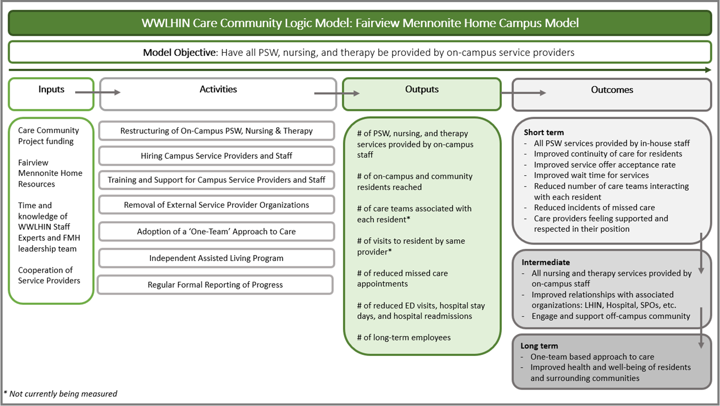
Notes:
To date only PSW – exploring options for therapy and nursing

Slide 6
Improved Patient and Provider Experience
Positive patient experience:
Residents reported a high level of understanding and consistency with the staff providing care
Missed care – 0.004% (one incident since the program started) - far below the target of 0.05%. Prior to the model, the Service Provider PSW missed care rate was 0.15% at FMH
Positive PSW job satisfaction:
Minimal staff turnover
PSWs feel they are an important part of the interdisciplinary care team and they are proud of the holistic care they are providing to the residents.

Slide 7

Health System Benefits
Maximizes health human resources capacity and created efficiencies in the system
Demonstrated more timely access to service and patient discharges from hospital – service offer acceptance rate – 98.6%.
Due to success at FMH, program expanded to Parkwood Mennonite Home in 2020

Slide 8
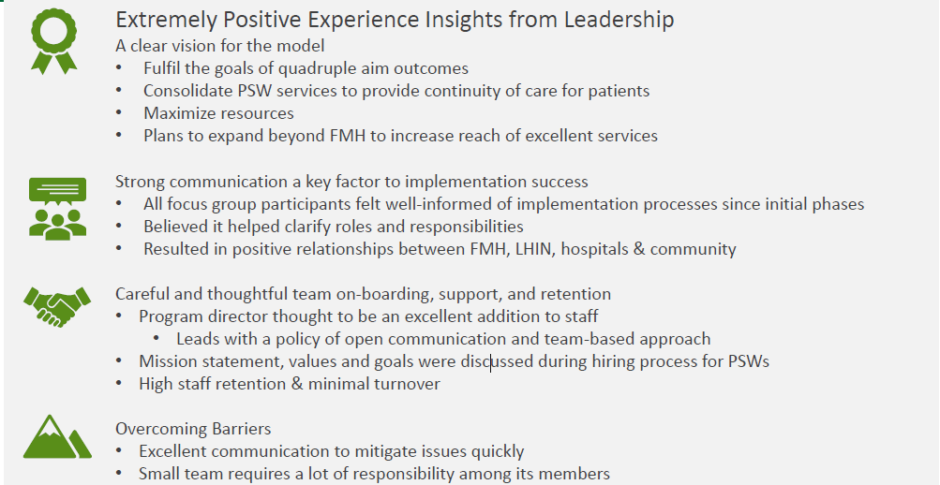
HCCSSWW and FMH Leadership Experience

Slide 9
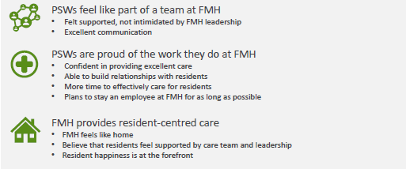
Care Provider Experience at FMH

Slide 10
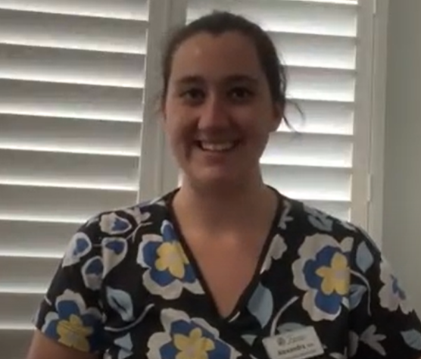
Personal Support Worker Story
Alex is a fulltime PSW at Fairview. Alex had previous experience with an external service provider and shares her story on the differences with the integrated model of care within the retirement home.
CLICK HERE

Slide 11
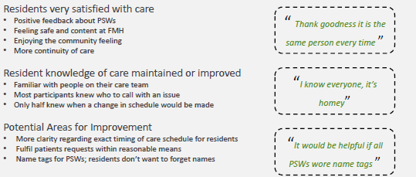
Resident Experience

Slide 12
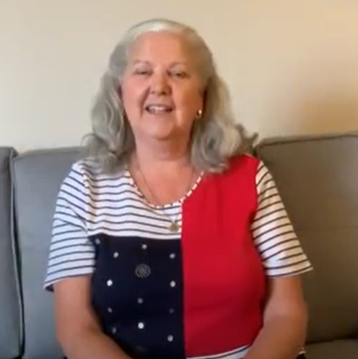
Family Experience
Living two hours away from her Mom, Sandy shares her experience with Fairview’s campus model of care. There is a clear trust between staff as a result of the increased continuity of care.
CLICK HERE

