Slide 1


Fixing Long-Term Care Act- Proposed Regulation Amendments Feedback
February 4, 2022

Slide 2
Overview
The Ministry of Long-Term Care (the "Ministry") is proposing Phase 1 regulations under the Fixing Long-Term Care Act, 2021 (the “Act”).
The Ministry is following a phased approach to the regulations.
The first phase of regulation development focuses on regulations needed to support the Act coming into force. The Ministry is carrying forward most of the provisions from Regulation 79 under the LTCHA.
Comments on the proposed Phase 1 regulations are due by February 17.
Today’s consultation focuses on the major revisions to the existing regulation.

Slide 3
Financial Impact of Proposed Regulations
Estimated average annual direct compliance costs for all long-term care homes in Ontario are between $20M to $23.5M, or approximately $36K on average for each long-term care home per annum.
Estimated costs associated with the proposal are primarily operational and administrative in nature and associated with the implementation of requirements necessary to operationalize legislative changes proposed under the Fixing Long-Term Care Act, 2021 in the areas of:
1. Emergency planning
2. Quality of care
3. Resident safety
4. Staffing
5. Accountability, enforcement, transparency and quality improvement
Please consider this number today as we go through the proposed regulations and include in your feedback your estimate of the actual costs of compliance with these changes for your home

Slide 4
61 | Palliative care requirements Relates to section 12 of the Act that requires home to provide residents with care or services that integrate a palliative care philosophy. | Resident must receive explanation of palliative care options. The palliative care assessment must be holistic and comprehensive. The section sets out minimum content for palliative care services (quality of life improvements, symptom management, psychosocial supports, end-of-life care).

Slide 5
77 | Menu planning requirements | Additional menu cycle requirements: (1) Primary entree and side dishes at all 3 meals and dessert at lunch and dinner. (2) Choice of snacks. (3) Before menu cycle in effect: (a) review by Resident Council, (b) evaluated by nutrition manager and RD staff members, (c) approved by staff member RD, taking under consideration requirements and DRIs. (4) Must keep record of evaluation under (b) including any changes. (5) No longer set times for breakfast and dinner - meals served at times agreed by Resident Council and Administrator. (LTCHA R71)

Slide 6
102 | Infection prevention and control program (IPAC) requirements | Additional requirements from Act (section 23 versus LTCHA 89): Evidence based procedures Educational component for staff, residents, volunteers, and caregivers. Additional requirements in Reg: Home must implement all Director protocols IPAC teams must include IPAC lead, MD, ND and Admin Local MOH invited to all meetings Program evaluation in accordance with Director protocols Implementation in accordance with current medical evidence and precautionary principle as set out in Director protocol

Slide 7
102 | Infection prevention and control program (IPAC) requirements | Six additions to education and experience qualification of IPAC Lead (including certification within 3 years of section coming into force) List of IPAC Lead responsibilities Minimum hours/week for IPAC Lead (and evaluation if additional Lead necessary) Quality management program for IPAC (as set out in Director protocol) IPAC contact information (monitored regularly) to MOH or OPAC Hub. (LTCHA R229)

Slide 8
165-169 | Quality improvement initiative – A42 Compare to LTCHA R228 | 166 – Committee composition and responsibilities (must have Committee 6 months after section coming into force). 167 – Designated lead must be staff member. 168 – Report on quality improvement initiative: mandatory content and record keeping requirements (experience survey date and results, communication of results, action taken on results and more generally, role of resident council and Committee in actions, dates actions communicated to residents) 169 – record of names of persons who evaluated in evaluation of improvements

Slide 9
253-257 | Hiring staff, accepting volunteers | Organizational changes: Police checks in separate section from declarations and different sections for charges, convictions, and professional misconduct. Additional offences subject to screening. Limitation period for screening for certain charges and convictions (5 years back). Police checks for staff and volunteers hired during pandemic required within 3 months. New screening requirements for directors and members of committee or board of management. {LTCHA R215)

Slide 10
269-71 | Emergency plans Compare to LTCHA R230 | Additional requirements: More detail on who to consult while developing/updating Four additional events to plan for, More requirements for evacuation planning Specification for resources and equipment and entities in responding to emergencies – and their role and how home will consult with them Plan for provision of food, fluid, and drugs Specification for plan activation Specifications for communication

Slide 11
269-71 | Emergency plans Compare to LTCHA R230 | Additional requirements: Evaluation within 30 days following emergency declared over, including feedback from entities involved in emergency Additional events subject to testing (gas leaks, boil water advisories) Additional requirements relating to recovery from emergency* Additional requirements for pandemic and epidemic planning MOH must be invited to participate in emergency planning relating to matters with "public health significance" IPAC Lead must be involved with respect to emergency planning for pandemics and outbreaks Requirements and content relating to attestation in A90 – attesting to compliance with emergency planning requirements (LTCHA R230)

Slide 12
350 | Administrative monetary penalties In existing regulation but not proclaimed. | Director or inspector may issue AMP with a compliance order. Director may issue AMP after an inspector referral. Table in regulation sets out requirements subject to AMPS and amount of AMP. Rules for AMP amounts for continuing non-compliance. Mandatory AMPs for repeat non-compliance with 3 years if compliance orders were issue for the initial and repeat non-compliance. (LTCHA R299.2)

Slide 13
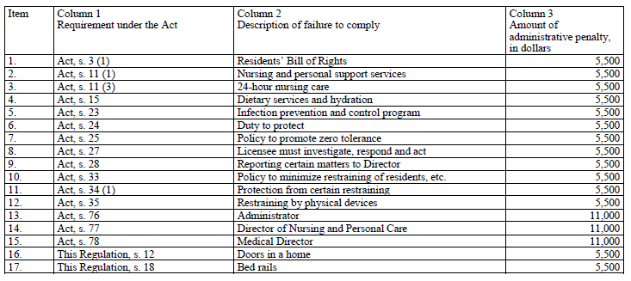

Slide 14
Thank you
If you have any further comments and feedback, please send them to:
Olivia Nero
Director, Public Policy
onero@advantageontario.ca

Slide 15
4 | Definition of "Caregiver" for the purpose of the Act and Regulation. New definition. Summary: Family, friend or important person At least 16 Provides paid or unpaid support or assistance Designated in writing | Material additions: Recognized in preamble and Bill of Rights (A3) IPAC must have educational component (A23) Experience survey must include caregivers A(43) Caregivers are essential visitors and must under visitor policy have access during pandemic and outbreaks (R268) (see 268 for new visitor policy)

Slide 16
252 | Medical Director | Agreement to include completion of Medical Director course, other training, and minimum hours - 6 month transition period. New responsibility re oversight of resident clinical care. (LTCHA R79-81)
268 | Visitor policy | New. Visitor policy required with minimum required content set out. Homes must retain visitor logs for 30 days.
272 | Website | New. Licensee must have a website with required content, including contact information for administrator, ND and IPAC lead, and Ministry toll-free number for making complaints, and emergency plan and visitor policy. 6 months transition period.
279-83 | Staff and volunteer records | Additional content relating to screening records. Records for volunteers and board members who have responsibilities at more than one home must be kept at each home (like staff currently).

