Slide 1
Refined Strategic Plan Framework (Post Retreat #2)
March 2, 2022

Slide 2
1. Review of outputs from last session

Slide 3
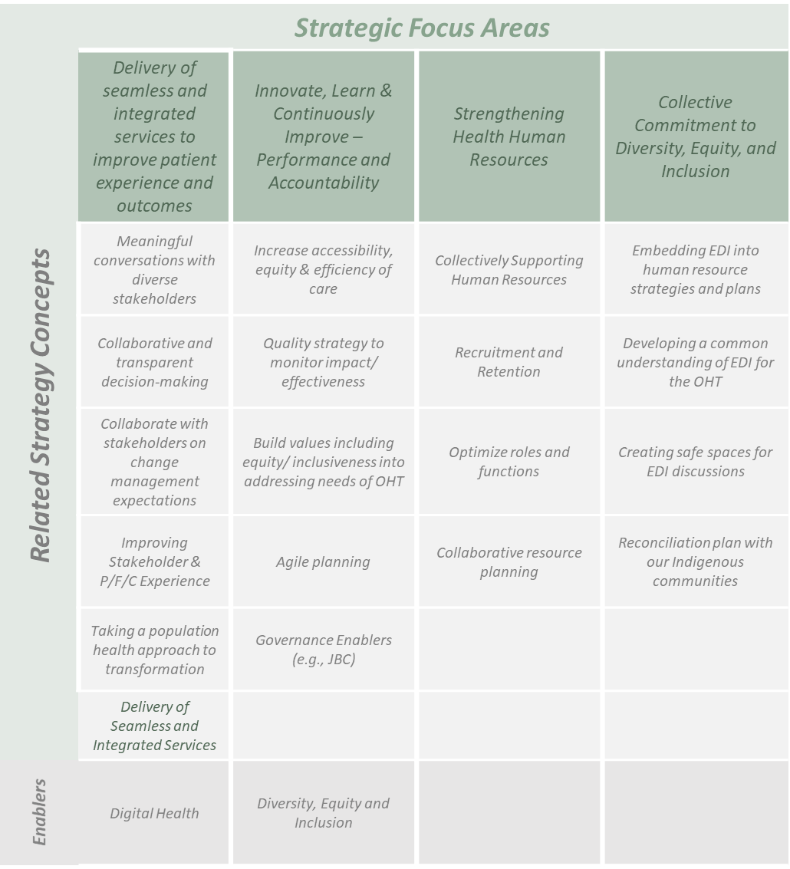
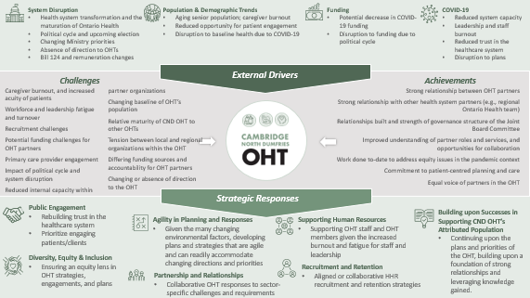
Review of last session
Reviewed CND’s achievements, challenges and external drivers and strategic responses to inform the first draft of the strategic plan framework

Slide 4











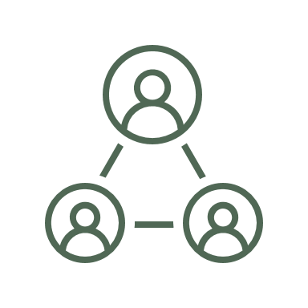

External Drivers
System Disruption
Health system transformation and the maturation of Ontario Health
Political cycle and upcoming election
Changing Ministry priorities
Absence of direction to OHTs
Bill 124 and remuneration changes
Population & Demographic Trends
Aging senior population; caregiver burnout
Reduced opportunity for patient engagement
Disruption to baseline health due to COVID-19
Funding
Potential decrease in COVID-19 funding
Disruption to funding due to political cycle
COVID-19
Reduced system capacity
Leadership and staff burnout
Reduced trust in the healthcare system
Disruption to plans
Challenges
Achievements
  Caregiver burnout, and increased acuity of patients
  Workforce and leadership fatigue and turnover
  Recruitment challenges
  Potential funding challenges for OHT partners
  Primary care provider engagement
  Impact of political cycle and system disruption
  Reduced internal capacity within partner organizations
  Changing baseline of OHT’s population
  Relative maturity of CND OHT to other OHTs
  Tension between local and regional organizations within the OHT
  Differing funding sources and accountability for OHT partners
  Changing or absence of direction to the OHT
  Strong relationship between OHT partners
  Strong relationship with other health system partners (e.g., regional Ontario Health team)
  Relationships built and strength of governance structure of the Joint Board Committee
  Improved understanding of partner roles and services, and opportunities for collaboration
  Work done to-date to address equity issues in the pandemic context
  Commitment to patient-centred planning and care
  Equal voice of partners in the OHT
Strategic Responses
Public Engagement
Rebuilding trust in the healthcare system
Prioritize engaging patients/clients
Building upon Successes in Supporting CND OHT’s Attributed Population
Continuing upon the plans and priorities of the OHT, building upon a foundation of strong relationships and leveraging knowledge gained.
Agility in Planning and Responses
Given the many changing environmental factors, developing plans and strategies that are agile and can readily accommodate changing directions and priorities
Supporting Human Resources
Supporting OHT staff and OHT members given the increased burnout and fatigue for staff and leadership
Diversity, Equity & Inclusion
Ensuring an equity lens in OHT strategies, engagements, and plans
Recruitment and Retention
Aligned or collaborative HHR recruitment and retention strategies
Partnership and Relationships
Collaborative OHT responses to sector-specific challenges and requirements

Slide 5


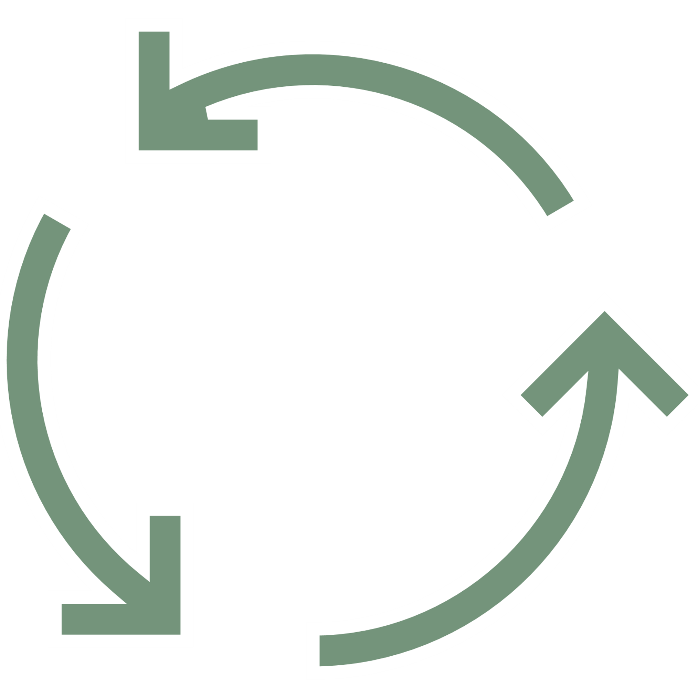
Previous Draft Plan Components
Vision | We envision a community where people access seamless and integrated services to ensure the health and wellbeing of our diverse populations
Values | Inclusive | Connected | Accessible | Adaptable
Improve experience of our stakeholders, including patients, caregivers and providers
Innovate, Learn and Continuously Improve
Collaborate across our OHT to build the foundation for longer term system integration
Continue to listen to our communities to understand needs around experiences
Create opportunities to communicate and collaborate with our diverse stakeholders, including opportunities for meaningful consultation to drive system transformation
Establish innovative opportunities to increase accessibility, equity and efficiency of care, including Digital Health solution.
Establish consistent ways to collect feedback and monitor patient, caregiver and provider experience across our OHT.
Create collaborative and transparent decision-making processes our stakeholders understand how OHT decisions are made
Develop a Quality strategy to monitor the impact and effectiveness of our work and identify opportunities for improvement.
Establish care coordination and care navigation functions in 5 primary care practices and evaluate impact
Work with our stakeholders to establish shared expectations around change management.
Build our values, including equity and inclusiveness, into how we work as an OHT and how we address the needs of our communities.

Slide 6
Exercise to develop the draft strategic framework

Slide 7
Exercise Outputs
From current plan
Improving Stakeholder & P/F/C Experience
Collaborate & build foundation for integration
Innovate, Learn & Continuously Improve
Public Engagement
Listen to community experiences
Meaningful conversations with diverse stakeholders
Increase accessibility, equity & efficiency of care
Partnership and Relationships
Consistent mechanisms for feedback
Collaborative and transparent decision-making
Quality strategy to monitor impact/effectiveness
Supporting Human Resources
Care coordination & system navigation in 5 primary care practices
Collaborate with stakeholders on change management expectations
Build values including equity/inclusiveness into addressing needs of OHT
Agility in Planning and Response
Digital Health Enablers
Governance Enablers (e.g., JBC)
Joint Communications and Messages
Diversity, Equity, and Inclusion
Operational Alignment
Trust between OHT Partners
Alignment to regional and provincial strategies
Building upon success with priority populations
Refining and aligning priority populations
Other…
Other…
Recruitment and Retention

Slide 8
Refined Framework

Slide 9




Draft Plan Components
Vision | We envision a community where people access seamless and integrated services to ensure the health and wellbeing of our diverse populations
Values | Inclusive | Connected | Accessible | Adaptable
Deliver seamless and integrated services to improve patient experience/outcomes
[direction]
Innovate, learn & continuously improve
Strengthen Health Human Resources
Promote Diversity, Equity, and Inclusion
Transform the health care journey for our priority populations and develop a model for transforming care for everyone we serve
Develop a quality improvement and performance measurement framework to monitor the impact and effectiveness of the OHT
Develop a plan to optimize the roles and functions of health human resources across our OHT
Eliminate experiences of racism, oppression and inequity for our patients and providers
Increase accessibility, equity and efficiency of care
Collaborate with other OHTs to share best practices and identify opportunities for partnership to improve care
Develop a collaborative human resource plan to promote recruitment across all OHT partners
Develop an EDI human resource strategy so our staff best reflect the diversity of our community
Increase the engagement and participation of patients, families and caregivers in the transformation of the health care journey
Evolve the governance of our OHT to promote transparent and collaborative decision making to guide strategic and operational activities
Improve the health care provider provider experience and increase engagement and participation in the OHT
Develop a reconciliation plan with our Indigenous communities
Continuously align our approaches with regional and provincial strategies
Enablers | Commitment to Patient/Client-Centricity | Digital Health
Notes:
Enabling co-design to drive population health
Two additional potential actions: Establish a commitment to embed DEI in the CND OHT, partner with diverse communities to actively engage on OHT implementation.
Important point Helen - intentional recruitment (beyond building awareness of EDI as important within existing teams, as an example). More in line with what I was thinking
I would see the population health under seamless and integrated services...?
Need to be outcomes focused (i.e., meaningful conversations, etc.)

Slide 10
Next Steps

Slide 11
Next Steps
Draft Strategic Plan Framework
Engagement with Key Stakeholders
Approval
February 25
March 23 to April 6
April 19 to May 17
  Approval of the final plan at Steering Committee (April 19)
  Approval of the final plan at JBC (April 25)
  Official launch of Plan at Annual Meeting (May 17)
Review/revise OHT strategic directions
Confirm 2022-23 goals
Identify key lines of action
Confirm next steps for Strategic Directions
Quality Co-Design Group (March 30)
Connected Care Co-Design Group (March 23)
Affiliate Members (March 29)
Primary Care Collaboration (April 6)
Joint Board Committee and Member Boards (March 28)
Community Engagement (TBD)

